Slide 1


G459
PS 3-1.
2025
CAREBOT
GUIDING YOU TO THE RIGHT CARE, EVERY TIME
Presented By:
M. Shiva Vardhan
RollNo:
23BD1A6736
Mentor:
Nidhi mam

Slide 2
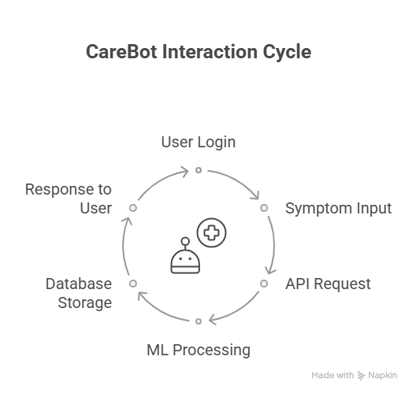
CareBot – AI-powered healthcare assistant for preliminary medical diagnosis.
OVERVIEW
Enables users to log in securely and interact via a chatbot interface.
Integrates Guideline Verifier to ensure medical accuracy and compliance.
PS 3-1
Uses Machine Learning (ML) for symptom extraction and diagnosis generation.
Mimics clinical reasoning of healthcare professionals using explainable AI.
Focus : Deliver fast, empathetic, and intelligent pre-diagnosis support.

Slide 3
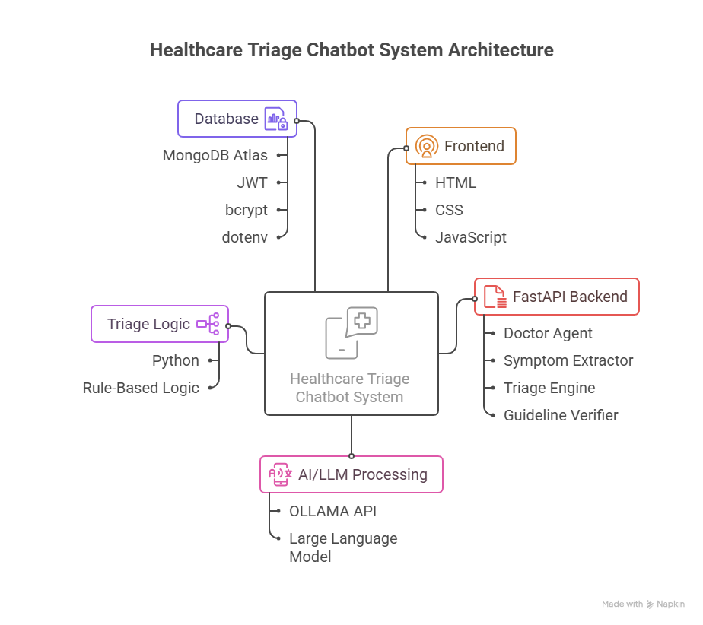

ARCHITECTURE DIAGRAM
Frontend Layer : Built with HTML, CSS, and JavaScript to provide an interactive chat interface for users.
Backend Layer : Powered by FastAPI; manages authentication (JWT), routing, and session handling.
AI Logic Modules : Includes Doctor Agent for conversational responses and Symptom Extractor for structured health data.
Triage & Verification Layer : Contains the Triage Engine and Guideline Verifier to assess urgency and ensure medical accuracy.
Database Layer : Uses MongoDB Atlas (Motor Driver) to store user data and chat history.
Utilities : Handles password hashing (Passlib), token management (JWT), and environment setup (dotenv).
External Services : Integrates OLLAMA API for AI model communication.

Slide 4
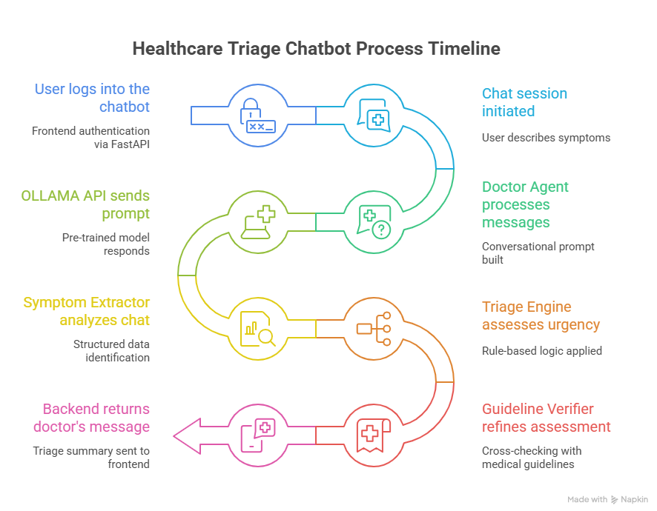
WORKFLOW DIAGRAM
User Input – Patient enters symptoms in the chatbot.
AI Processing – The chatbot uses the LLM (OLLAMA/OpenAI API) to understand symptoms.
Symptom Extraction – Key symptoms are identified using NLP models.
Triage Engine – The system analyzes severity and suggests next steps.
Guideline Verification – Medical guidelines are checked for accuracy.
Response Generation – AI forms a clear and safe response.
Frontend Display – Result shown to user via chatbot UI.
Data Storage – User chat and details saved securely in MongoDB.

Slide 5
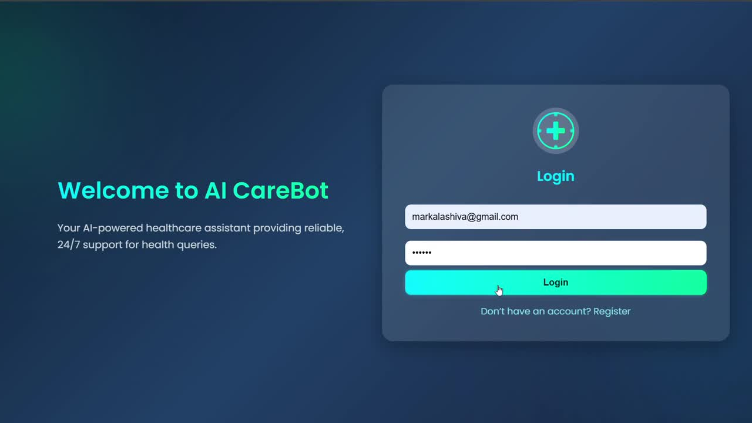

Slide 6
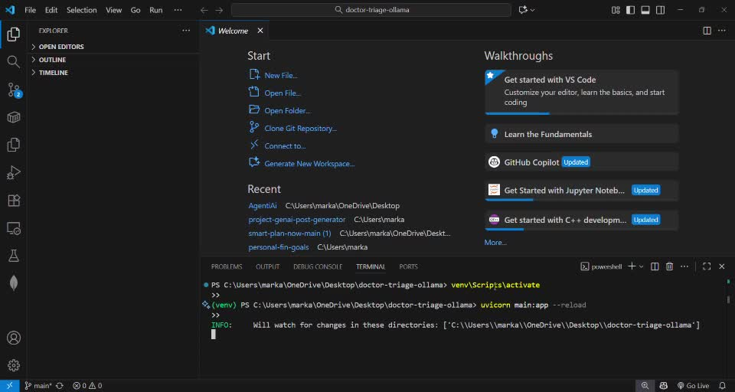

Slide 7
Key Learnings & Insights
Prompt-based pre-trained models effectively automate triage chatbots.
Extract structured info reliably from free text.
Continuous updates of symptom rules and guidelines are essential.
Potential Improvements
Add automatic diagnosis generation and tighter verification loops.
Cache symptom extraction to improve efficiency.
Integrate analytics for feedback and audit tracking.
Real-World Applications
Supports clinics by triaging patients efficiently.
Expands healthcare access in remote areas.
Useful as a screening tool for non-emergency cases.
Performance & Comparison
High accuracy on test cases; strong in identifying urgent symptoms.
Maintains fast response (<1s) with consistent reliability.
Challenges & Resolutions
Integrated multiple components via APIs.
Balanced guideline strictness vs. flexibility.
Limitations
Diagnosis not yet fully automated.
NLP symptom citation could be improved.

